Slide 1
Tutorial 02 Fundamentals of Artificial Intelligence
Hualie Jiang

Slide 2
Problem 1
1. Answer the following questions:
A goal-based agent is often used other than a reflex agent. Could you answer why? (L3: P9)
(b) As a problem-solving agent, please understand its two formulations: Goal and Problem Formulation. (L3: P11-17)
(c) A problem can be defined by five components, what are they? (L3: P18-19)

Slide 3
Goal-Based Agent vs Reflex Agent
Reflex Agent
Reflex = Lookup table direct mapping from states to actions
cannot work well in some environments when this mapping would be too large to store and would take too long to construct or learn
Goal-Based Agent
consider future actions & the desirability of their outcomes

Slide 4
Goal and Problem Formulation
Goal formulation, is based on the current situation and the agent’s performance measure.
Problem formulation, decides what actions and states to consider, given a goal.
A simple problem-solving agent. It first formulates a goal and a problem, searches for a sequence of actions that would solve the problem, and then executes the actions one at a time.

Slide 5
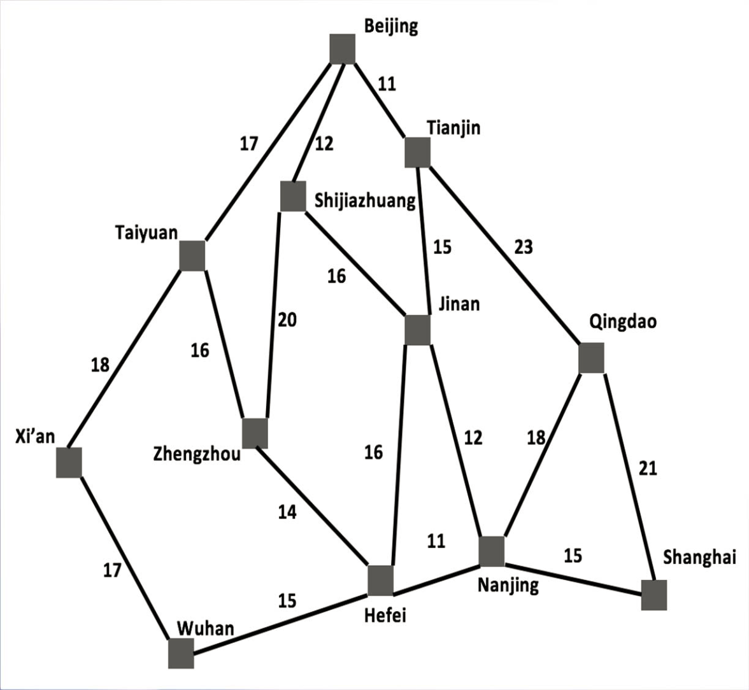
Problem Example
Driving from Beijing to Shanghai

Slide 6
Five Components of a Problem
Initial state: The initial state that the agent starts in
E.g., In(Beijing)
Actions: A description of the possible actions available to the agent. Given a particular state s, ACTIONS(s) returns the set of actions that can be executed in s.
E.g., from the state In(Beijing), the applicable actions are {Go(Taiyuan),Go(Shijiazhuang),Go(Tianjin)}

Slide 7
Five Components of a Problem
Transition model: A description of what each action does, specified by a function RESULT(s,a) that results from doing action a in state s.
E.g., RESULT(In(Beijing),Go(Tianjin)) = In(Tianjin)
the initial state, actions, and transition model implicitly define the state space of the problem— the set of all states reachable from the initial state by any sequence of actions.
A path in the state space is a sequence of states connected by a sequence of actions

Slide 8
Five Components of a Problem
Goal test: The goal test that determines whether a given state isa goal state.
E.g., check whether the state is In(Shanghai) or not
Sometimes the goal is specified by an abstract property, e.g., in chess, the goalis to reach a state called “checkmate,” where the opponent’s king is under attack and can’t escape.
Path cost: A path cost function that assigns a numeric cost to each path. The problem-solving agent chooses a cost function that reflects its own performance measure. The step cost of taking action a in state s to reach state s’ is denoted by c(s,a,s’).
E.g., c(In(Beijing), Go(Tianjin), In(Tianjian))=11

Slide 9
Problem 1
1. Answer the following questions:
(d) What are the variants of breadth-first search and depth-first search? (L3: P47)
(e) How to understand the five components for a given node? (L3: P41)
(f) What are the three types of queue? What difference between FIFO quere and LIFO queue, and how to implement each? (L3: P43)

Slide 10
The Variant of Breadth-First Search
Variant: Uniform cost search

Slide 11
The Variant of Depth-First Search
Variant: Depth-limited search
Variant: Iterative deepening search
Variant: Iterative lengthening search

Slide 12
The Five Components in A Node
STATE: which state it is in the state space
PARENT: from which node it is generated
ACTION: which action applied to its parent-node to generate it
PATH-COST: the cost, g(n), from initial state to the node n itself
DEPTH: number of steps along the path from the initial state

Slide 13
The Three Types of Queue
FIFO queue (first-in, first-out)
pops the oldest element of the queue
LIFO queue (stack) (last-in, first-out)
pops the newest element of the queue
Priority queue
pops the element of the queue with the highest priority according to some ordering function

Slide 14
Problem 1
1. Answer the following questions:
(g) Using expanding from initial state to goal in a search tree, some problems could be solved in final. How to avoid the repeated states during searching? (L3: P32-37)
(h) Please explain four kind of measuring performance to evaluate a search strategy. (L3: P44)
(i) Two type of search strategies, uninformed search and informed search, are defined in P46, L3. Could you compare their difference?

Slide 15
Avoiding Repeated States
Do not return to the state it just came from
Refuse generation of any successor same as its parent state
Do not create paths with cycles
Refuse generation of any successor same as its ancestor states
Do not generate any generated state
Not only its ancestor states, but also all other expanded states have to be checked against

Slide 16
Four kinds of measuring performance
Completeness:
Can a solution eventually be found? (Guaranteed?)\
Repeated states / loops / cycles can be avoided?
Optimality:
Is the found solution the best among many solutions?
Time complexity:
how long does it take to find a solution?
Space complexity:
how much memory is needed to perform the search?

Slide 17
Uninformed vs Informed Search
Uninformed search (blind search)
Have no information about the number of steps or path cost from the current state to the goal
Only generate successors and distinguish a goal state from a non-goal state
i.e., no guidance towards the goal at all.
Informed search, or heuristic search
a smart strategy that searches towards the goal based on the information from the current state so far

Slide 18
Problem 2
2. A problem can be formulated in different ways. Please formulate the 8 queens problem using incremental formulation and complete-state formulation. (L3: P26-29)

Slide 19
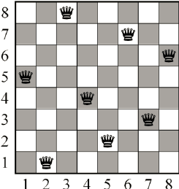
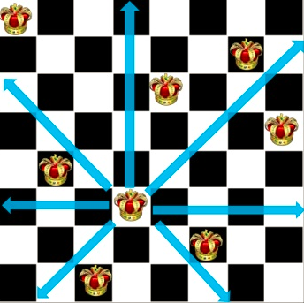
The 8 Queens Problem
The goal of the 8-queens problem is to place eight queens on a chessboard such that no queen attacks any other. (A queen attacks any piece in the same row, column or diagonal.)

Slide 20
Two Formulations
Incremental formulation
starting with an empty state;
each action adds a queen to the state.
Complete-state formulation
starts with all 8 queens on the board and moves them around

Slide 21
Incremental Formulation
One formulation may be:
States: Any arrangement of 0 to 8 queens on the board is a state.
Initial state: No queens on the board.
Actions: Add a queen to any empty square.
Transition model: Returns the board with a queen added to the specified square.
Goal test: 8 queens are on the board, none attacked.
In this formulation, we have 64 · 63 · · · 57 ≈ 1.8 × 10^14 possible sequences to investigate. A better formulation would prohibit placing a queen in any square that is already attacked:
States: All possible arrangements of n queens (0 ≤ n ≤ 8), one per column in the leftmost n columns, with no queen attacking another.
Actions: Add a queen to any square in the leftmost empty column such that it is not attacked by any other queen.

Slide 22
Complete-State Formulation
One formulation may be:
States: Any arrangement of 8 queens, one per column in the leftmost columns.
Initial state: all 8 queens on the board.
Actions: Move an attacked queen to a row, not attacked by any other.
Transition model: Returns the board after a queen is moved.
Goal test: 8 queens are on the board, none attacked
In this formulation, at most 7*6*5*4*3*2*1=7! =5040 different states.

Slide 23
Problem 3
3. What data structure should be used to store the frontier in breadth-first search, uniform-cost search and depth-first search, respectively? (L3: P48-54)

Slide 24
Data Structure
Breadth-First Search
Queue(FIFO)
Uniform Cost Search
Priority Queue
Depth-First Search
Stack(LIFO)

Slide 25
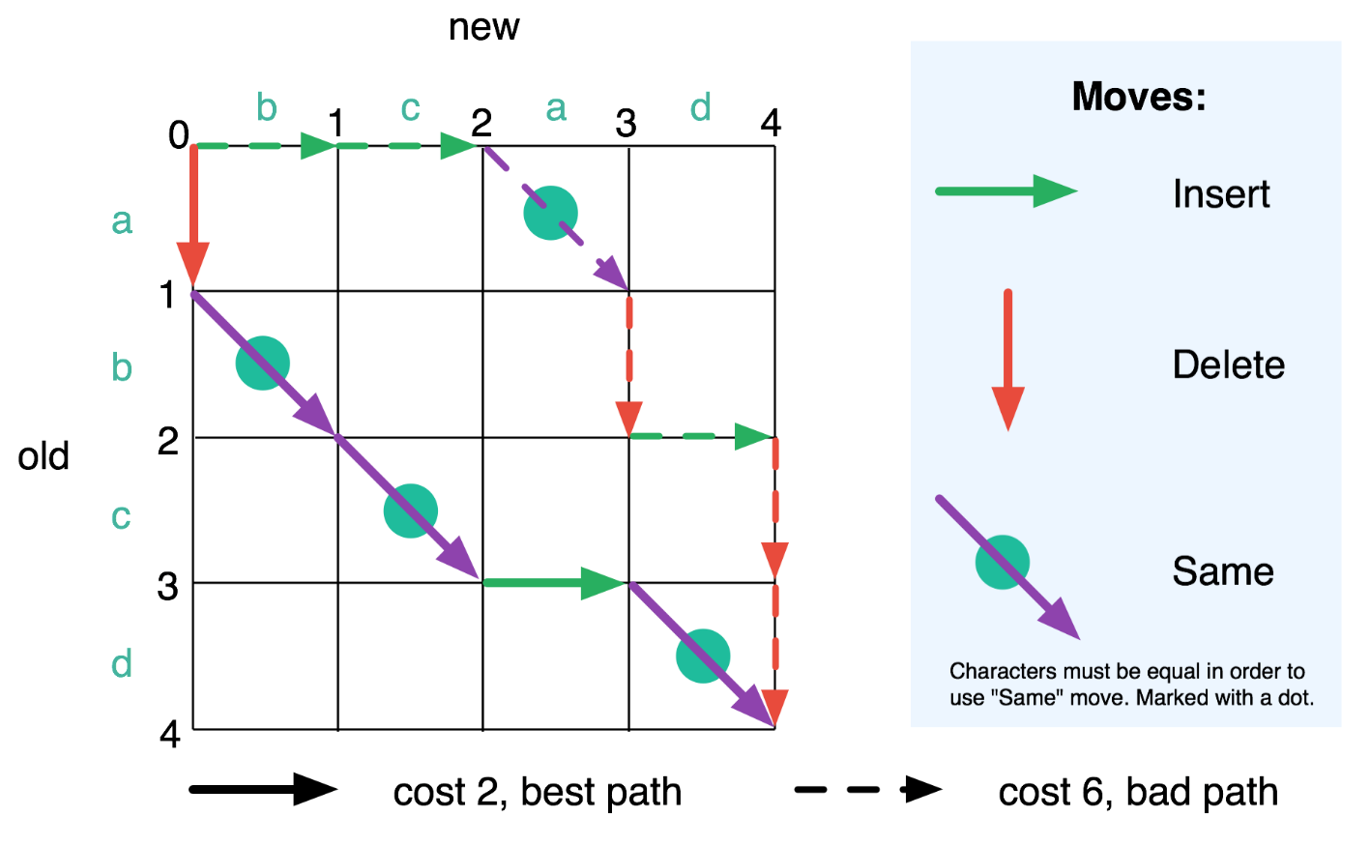
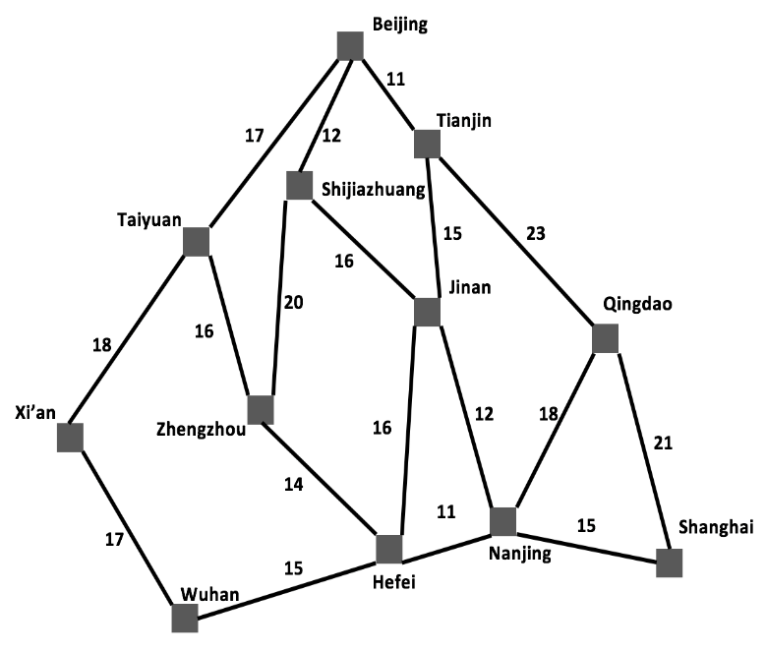
Problem 4
4. In Lecture 3, the solution of a problem is define as a path from the initial state to a state satisfying the goal test. As two examples in the following, please find out the optimal solution with lowest path cost among the given solutions.
Beijing→Shanghai

Slide 26
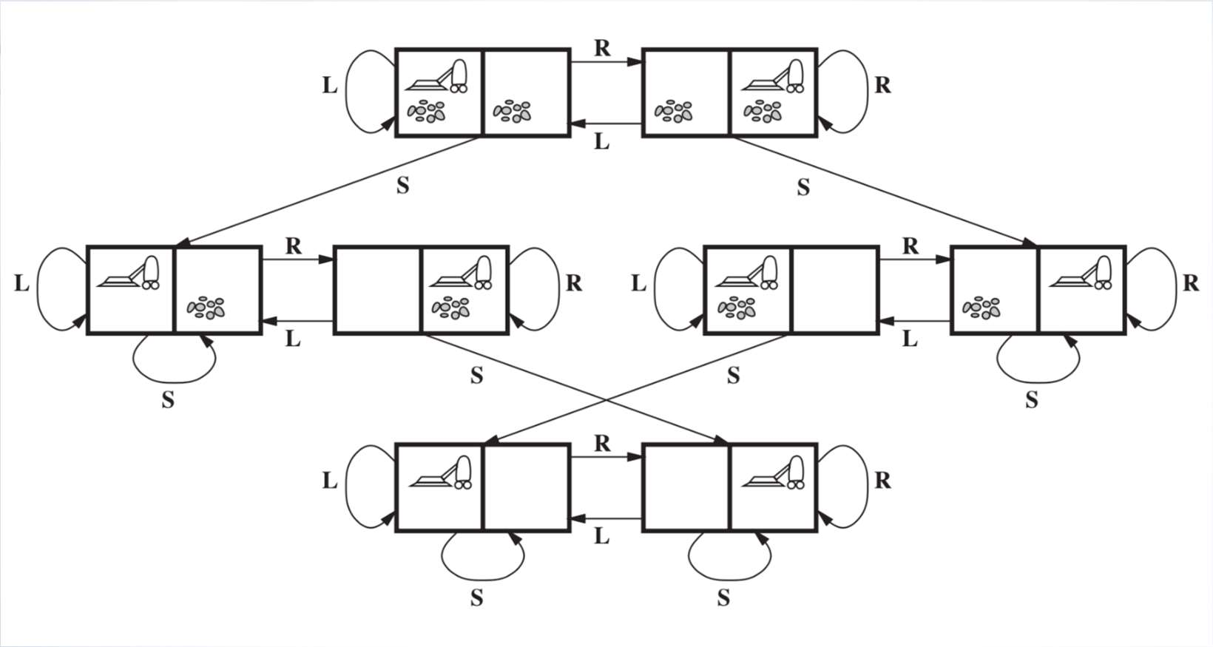
Problem 5
5. An example of Vacuum World is shown in P22, Lecture 2. There are the total 8 states. Could you use a truth table to represent each state?

Slide 27
Truth Table
Current States | Cleaner is in A | Cleaner is in B | A is Dirty | B is Dirty
1 | T | F | T | T
2 | F | T | T | T
3 | T | F | F | T
4 | F | T | F | T
5 | T | F | T | F
6 | F | T | T | F
7 | T | F | F | F
8 | F | T | F | F

Slide 28
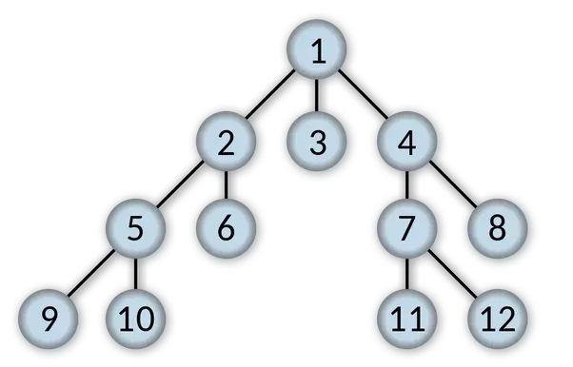
Problem 6
6. 6. Search the following tree using breadth-first search (L3: 48-50) and depth-first search (L3: 53-55) respectively (starting with node 1). What is the order of the expanded nodes?

Slide 29
Breadth-First Search
1,2,3,4,5,6,7,8,9,10,11,12

Slide 30
Depth-First Search
1,2,5,9,10,6,3,4,7,11,12,8

Slide 31
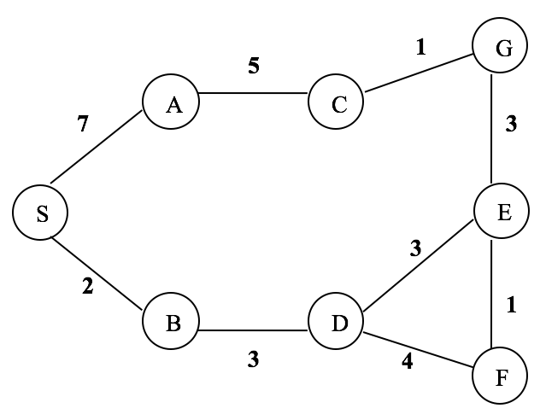
Problem 7
7. Search the following graph with breadth-first search and uniform-cost search respectively (S: starting state, G: goal state). What is the order of the expanded nodes? (L3: P51)

Slide 32
Breadth-First Search
S,A,B,C,D,G

Slide 33
Uniform-Cost Search
S,B,D,A,E,F,G

Slide 34
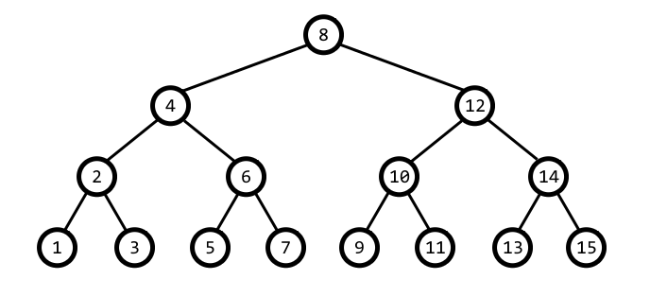
Problem 8
8. Given a binary tree as follows, we should like to search it using Breadth-First Search and Depth-First Search, respectively. Please list each number of nodes generated, time and space complexity.

Slide 35
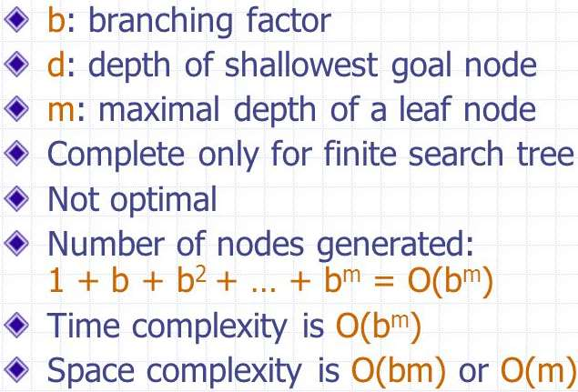
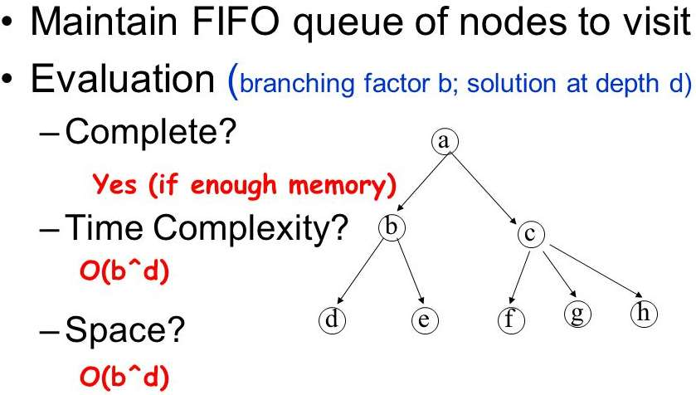
Problem 8
DFS
BFS

